Slide 1
Figures from Curbing Catastrophe
(Chapters Six and Seven)
Timothy H Dixon
University of South Florida
Tampa

Slide 2
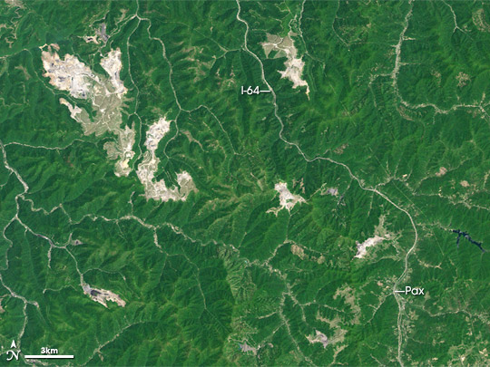
Notes:
Figure 6.1. A strip-mined area in West Virginia. Darker areas are forest-covered, large lighter areas have been strip-mined for coal, and thin curving white lines are either roads or stream valleys. Image from Landsat satellite provided by NASA’s Global Land Cover Facility and the NASA Earth Observatory. See R. Lindsey (2015) Mountain top mining, West Virginia, NASA Earth Observatory (earthobservatory.nasa.gov).

Slide 3
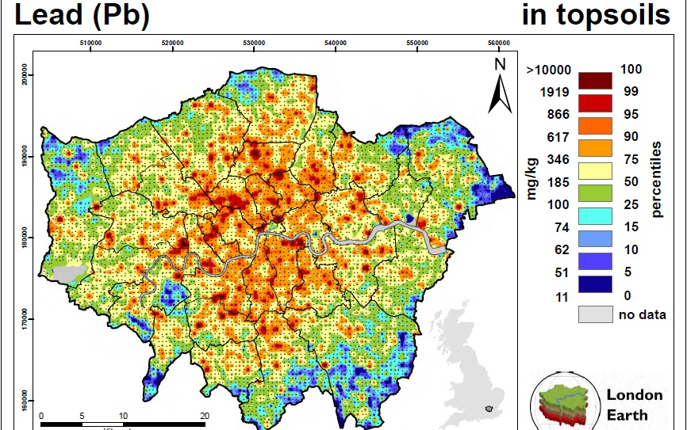
Notes:
Figure 6.2. Lead in topsoil in London, England, measured by the British Geological Survey in 2008-2009. The scale bar on the right is in units of milligrams (mg) of lead per kilogram (kg) of soil (mg/kg). Levels above 100 mg/kg are generally considered unsafe, although the Dutch government sets a standard of 40mg/kg. Note that most of central London exceeds even the higher value. Most major urban centers show similar levels of lead contamination in their topsoil. Reproduced by permission of the British Geological Survey © NERC. All rights reserved. CP14/021.

Slide 4
Table 6.1 – Methyl Mercury in Fish (ppm)
Seafood Type Average Maximum
Anchovies 0.04 0.34
Cod 0.11 0.42
Lobster (Spiny) 0.09 0.27
Lobster (Northern) 0.31 1.31
Salmon 0.01 0.19
Sardines 0.02 0.04
Shark 0.99 4.54
Swordfish 0.97 3.22
Tilefish (Atlantic) 0.15 0.53
Tilefish (Gulf of Mexico) 1.45 3.73
Tuna (albacore, canned) 0.35 0.85
Tuna (fresh/frozen) 0.38 1.30

Slide 5
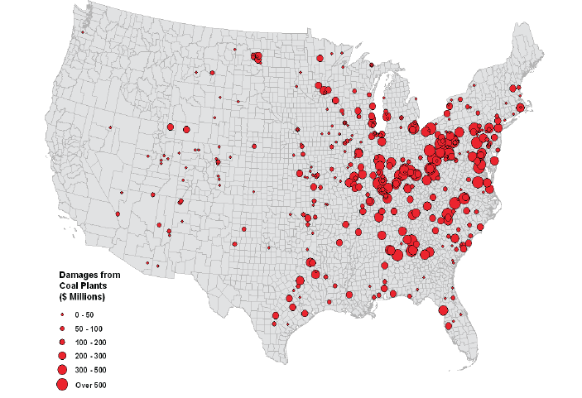
Notes:
Figure 6.3. Estimated “external” (unaccounted) costs in 2005 of 406 coal-burning power plants in the US. These costs mainly reflect premature deaths from air pollution, based on estimated lost earning potential and taxes, and do not include “upstream” costs (e.g, land degradation from coal mining) or “downstream” costs (e.g., surface water pollution from mercury or fly ash, ground water pollution, or global warming). From National Academy (2010).

Slide 6
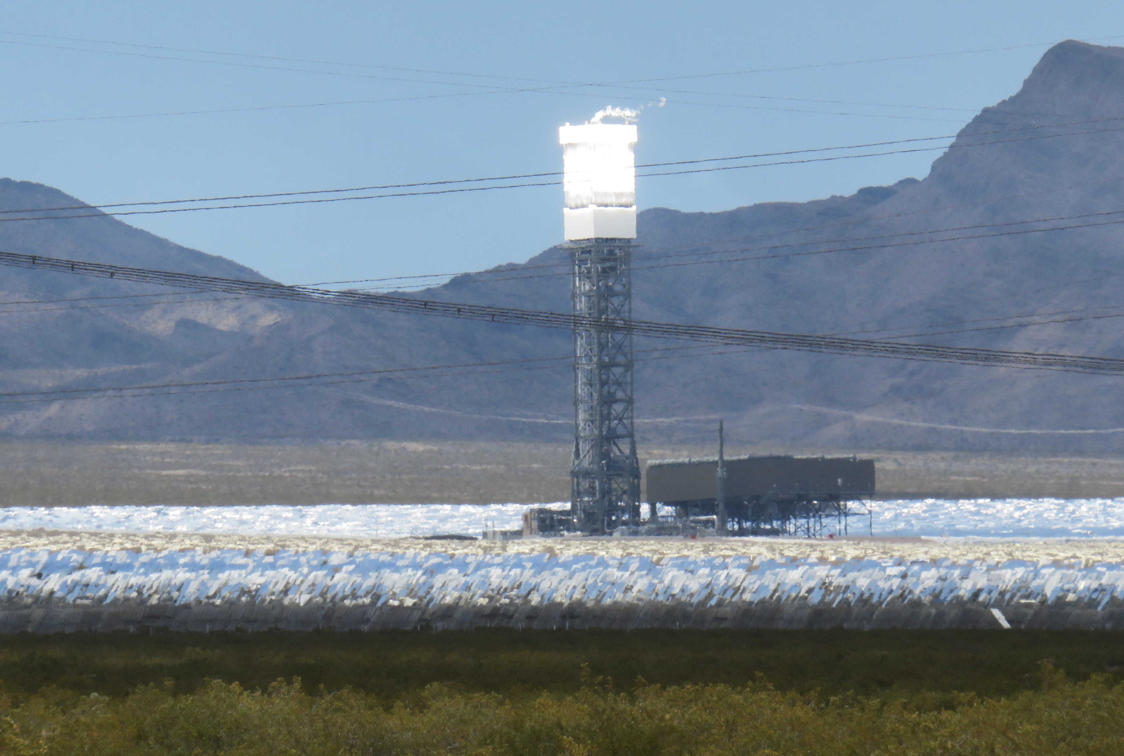
A Solar-Thermal Plant in California
Notes:
Figure 6.4. A solar-thermal plant in southeastern California. Mirrors on the ground focus sunlight on the central tower to heat a working fluid, which drives a turbine.

Slide 7
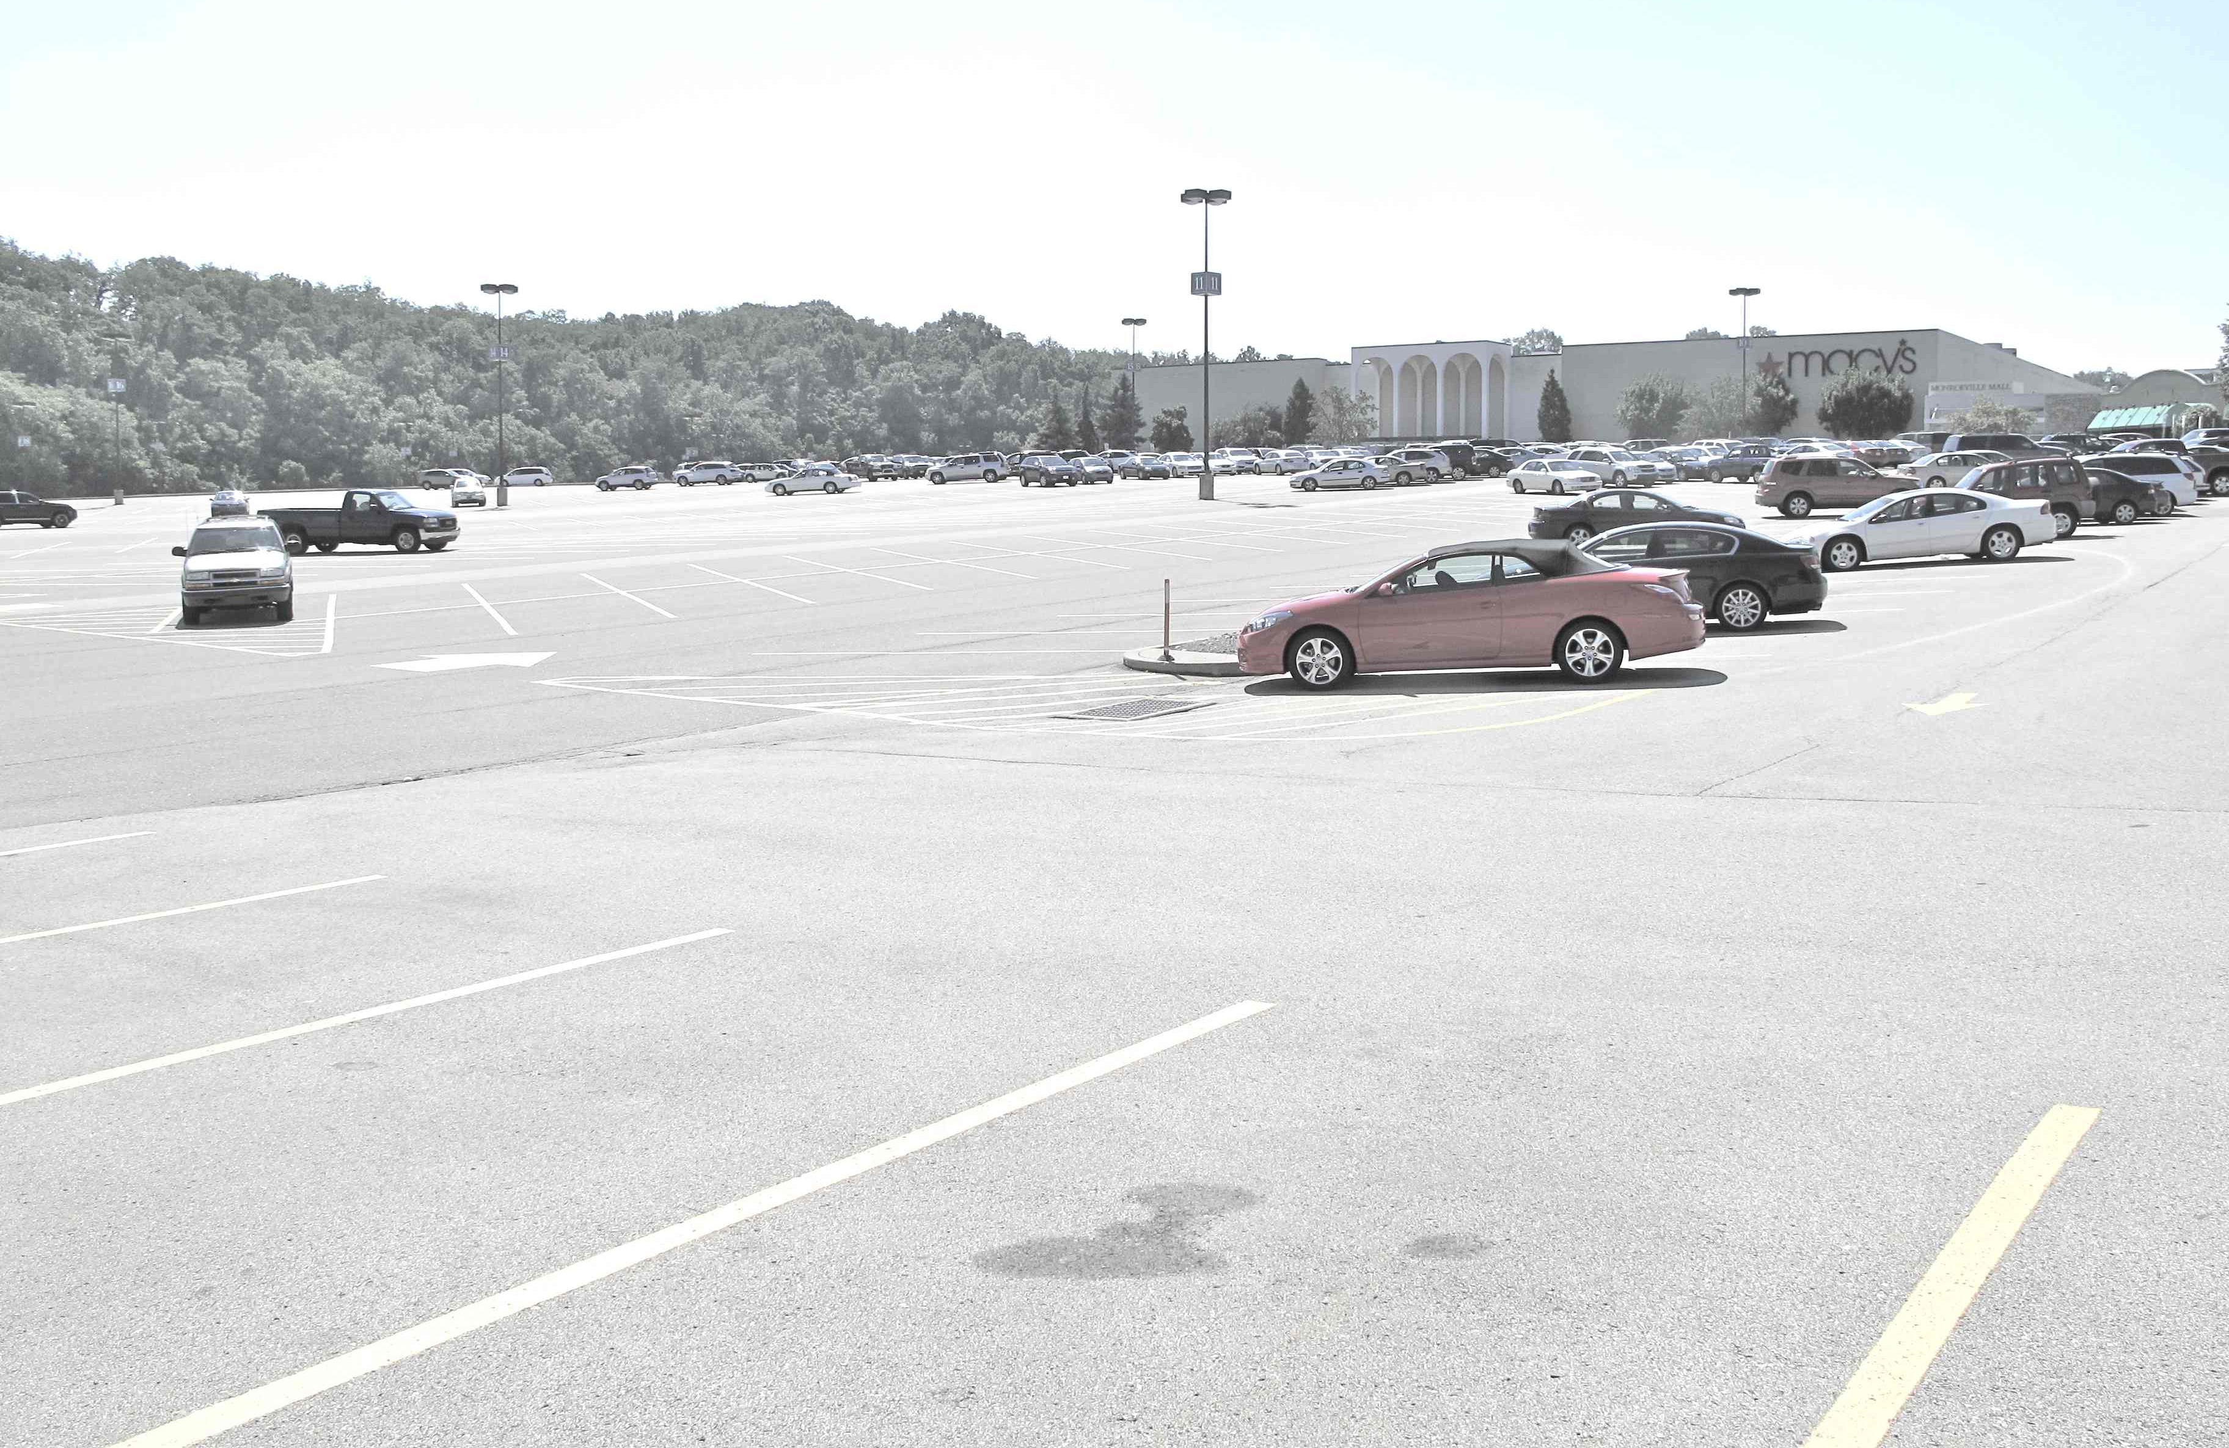
Notes:
Figure 7.1. A large suburban parking lot near Pittsburgh, Pennsylvania, typical of many suburban areas in the US and other industrialized countries, with extensive “hardscape”. Elimination of green space reduces percolation of rainwater into the ground, forcing run-off to flow immediately into adjacent streams or rivers, causing flooding during high rainfall events. Note the oil patch in the foreground, a common surface deposit on city streets and parking lots. Run-off from these deposits includes toxic substances that course through our streams and rivers, eventually winding up in the ocean, and in the fish we eat. Photo by the author, taken August 2012.

Slide 8
Table 7.1 Saffir-Simpson Hurricane Scale
Category Maximum Sustained Damage
Wind Speed
Km/hr Miles/hr
1 119-153 74-95 Minimal
2 154-177 96-110 Moderate
3 179-209 111-130 Extensive
4 210-249 131-155 Extreme
5 >250 >156 Catastrophic

Slide 9
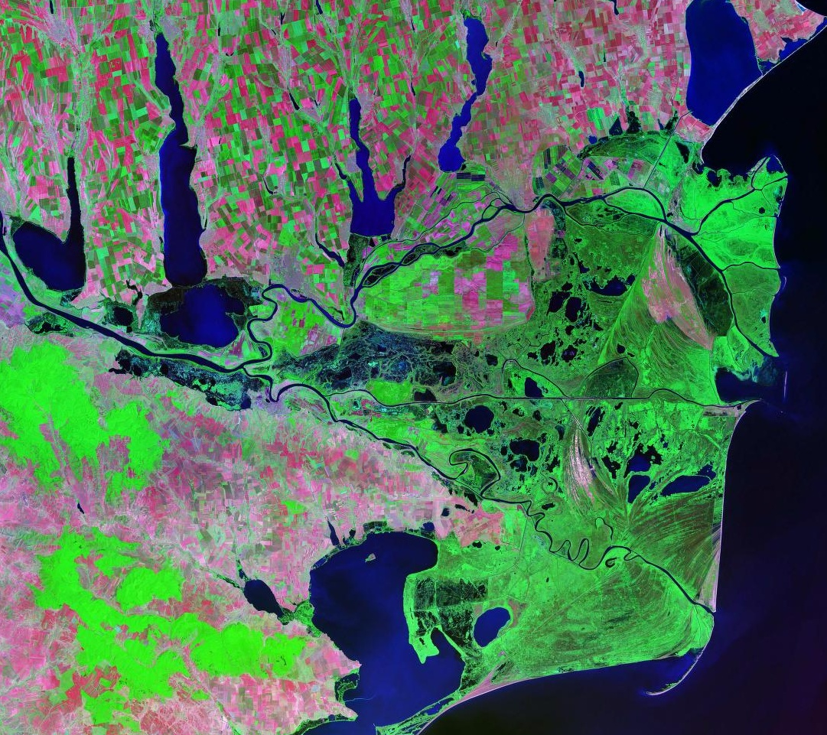
Notes:
Figure 7.2. The Danube River in Romania, near its border with Ukraine, ends in a classic delta shape, where the river empties into the Black Sea. It is one of the largest deltas in Europe, and parts of it have been designated a World Heritage site due to unique wetland ecosystems. This image is from NASA’s Landsat satellite. Image courtesy of NASA.

Slide 10
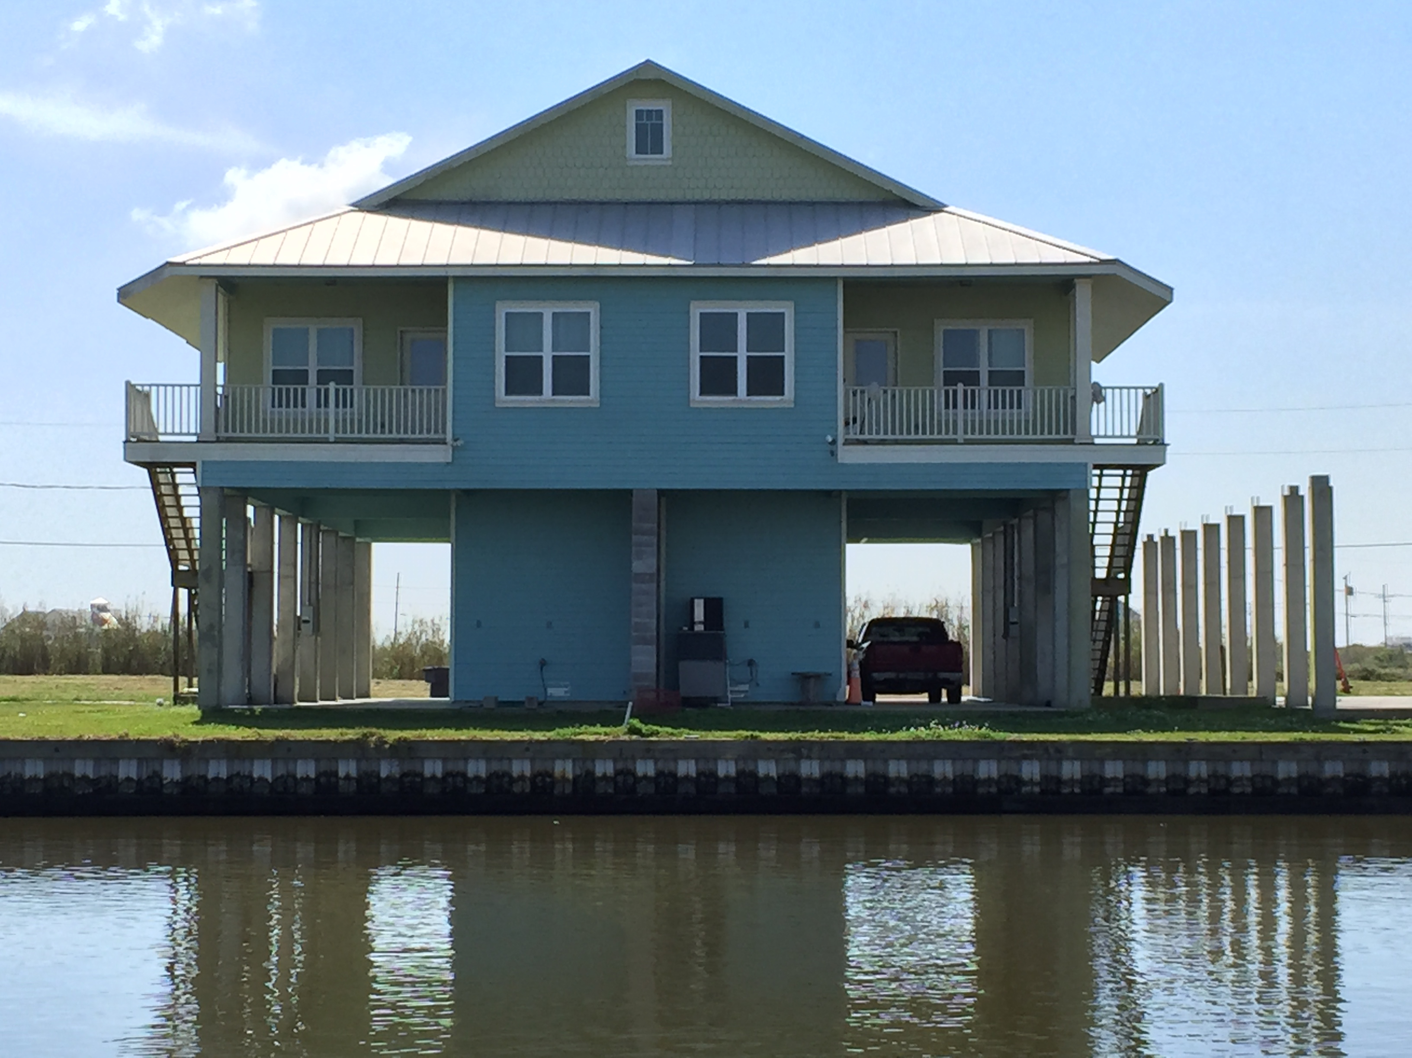
Notes:
Figure 7.3. A delta house, with the main living space on the second floor. Photo by the author, taken March 2016.

Slide 11
Notes:
Figure 7.4. Global sea level was first measured precisely from satellite in 1979 by NASA’s Seasat satellite. Since 1992 it has been measured more or less continuously by a suite of satellites from various nations. The technique involves a radar altimeter to measure the height of the satellite above the ocean surface, and precise orbital tracking to correct for satellite location and motion. Unlike tide gauges which are restricted to a relatively small number of coastal locations, satellites obtain full global coverage. The satellite data show a higher rate of sea level rise (approximately 3.3 mm/yr) compared with the 20th Century average (1.5- 2.0 mm/yr, e.g., Figure 2.7), suggesting that sea level rise is accelerating. Data courtesy of the French space agency CNES (Centre National d'études Spatiales).

Slide 12
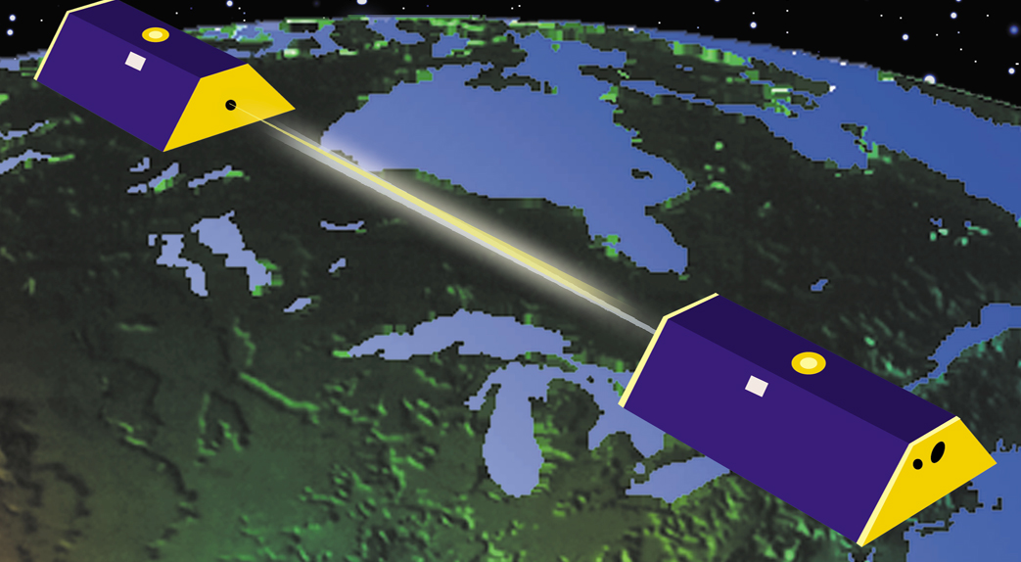
Notes:
Figure 7.5. Artist’s conception of the twin GRACE spacecraft in orbit. The two spacecraft are separated by about 200 km (125 miles) and a sensitive microwave system (basically a radar) continuously measures the distance between them. Image courtesy of NASA.

Slide 13
Greenland Mass Change
from GRACE
Notes:
Figure 7.6. GRACE data showing monthly mass estimates for the Greenland ice sheet (small black circles) between 2002 and 2014, arbitrarily setting the starting point (the average of the first year’s measurements) to zero. Note the annual changes, reflecting summer melting and winter growth, and the longer term loss of ice (the downward trend of the graph). Note also that the losses are accelerating (the graph curves downward). During this particular period, Greenland lost more than 2500 Gigatons (2500 billion tons) of ice, roughly 0.1% of its total. During the first five years of the mission, Greenland lost mass at an average rate of about 200 Gigatons per year. During the next five years, the average loss rate increased to about 300 Gigatons per year. The thin line shows a model fit to the data assuming a constant annual cycle (winter growth, summer loss) and constantly accelerating long term mass loss at 20 Gt per year per year; i.e., every year, the rate of loss increases by 20 GT/yr. Modified from Yang et al. (2016).

Slide 14
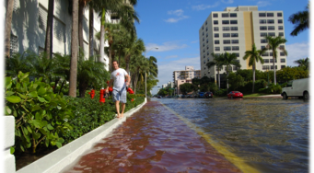
Notes:
Figure 7.7 (top and bottom): Two pictures of “Sunny day flooding” in Miami Beach during a “king tide”. Note the blue sky. Photographs courtesy of Miami-Dade DERM.

Slide 15
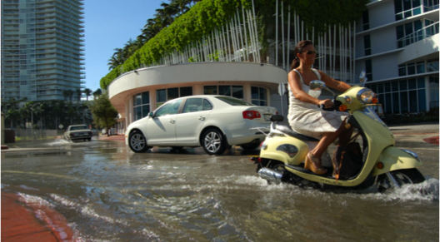

Slide 16
Frequency of Sunny Day Floods in Miami Beach, Florida
Notes:
Figure 7.8. Frequency of flood events in Miami Beach, Florida. Modified from Wdowinski et al. (2016).

Slide 17
What goes up…
Notes:
Figure 7.9 Glacial isostatic adjustment (GIA). A: glaciers load the northern part of a northern hemisphere continent (North America or Scandinavia), reaching a maximum about 20,000 years ago. Their weight depresses the landscape beneath, but peripheral areas are slightly elevated.

Slide 18
…will come down
Notes:
7.9B: After the glaciers melt, the land beneath them begins to rise; the residual depression becomes a shallow bay (e.g., Hudson Bay in North America). The peripheral bulges slowly collapse. Both the central uplift and the peripheral bulge collapse continue today, related to the viscosity of Earth’s mantle, which flows slowly and slows down the adjustment process.

Slide 19
Storm Surge during Sandy
Notes:
Figure 7.10. Water level at The Battery, New York, as measured by a tide gauge, showing storm surge associated with Hurricane Sandy beginning at midnight (OO hours) on October 29, 2012. At the height of the storm, local sea level was 9 feet (nearly 3 meters) above normal. Note that water levels stayed elevated for more than a day. Data courtesy of NOAA/NOS.

Slide 20
Notes:
Figure 7.11. Average sea surface temperature (SST) in the North Atlantic since 1970, relative to the average temperature from 1901 - 1970. Modified from Yang et al. [2016].

Slide 21
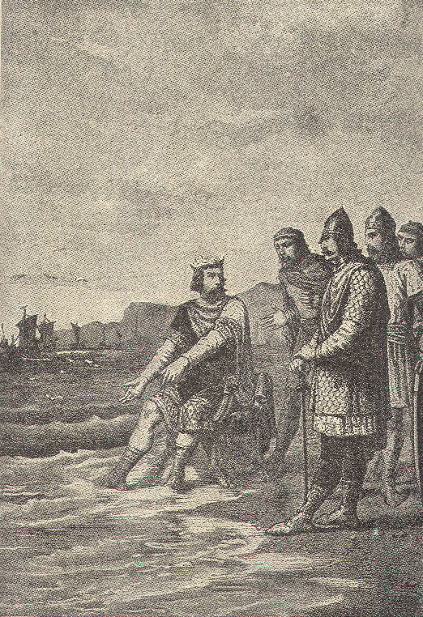
King Canute commands the tides to stop. From a 19th century drawing by French artist Alphonse-Marie-Adolphe de Neuville
Notes:
Figure 7.12. King Canute commands the tides to stop. From a 19th century drawing by French artist Alphonse-Marie-Adolphe de Neuville

